Slide 1

The University of Prishtina “Hasan Prishtina” The Faculty of Electrical and Computer Engineering
Course: Operating Systems
Topic: Hybrid Operating Systems
Worked: Fortesa Mujaj, Alberiana Tofaj Professor: Prof. Dr. Artan Mazrekaj
Veranda Blakaj, Arlinda Kastrati

Slide 2
Introduction
Hybrid Operating System
Performance
Security
Usability
The Hybrid Operating System may allow one operating system to fulfil one set of requirements and the other operating system to fulfil the rest.

Slide 3
Features of Hybrid OS
Two OS may execute on a single device.
Two OS on a computer system may include a full-fledged OS and a lightweight OS.
One of the ways to install the two OS is to bootstrap the first OS with all the system resources.
Another method is hypervisors.
Both the operating systems in the hybrid environment may be aware of the other operating system and share resources with each other.

Slide 4

Apple MacOS
Hybrid Operating Systems
iOS
Android

Slide 5
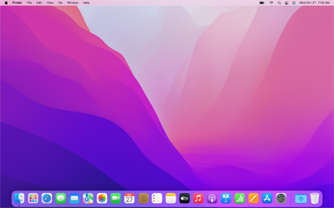
Apple MacOS
The Macintosh Operating System (MacOS)
Introduced In 1984
Similar to Windows or Linux OS

Slide 6
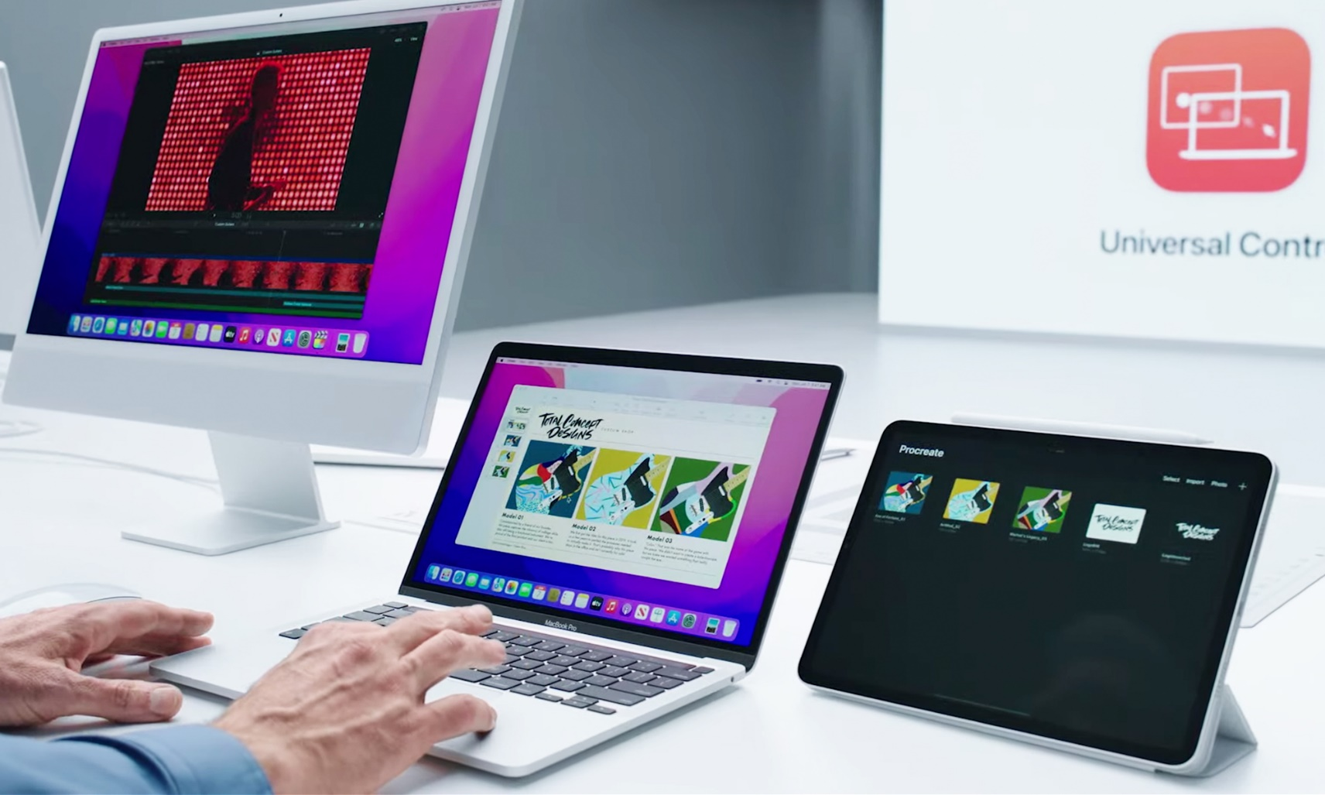
MacOS…
Hybrid structure
First version Mac OS X 10.0, March 2001
Latest version Mac OS 12, October 2021
39 system languages available

Slide 7
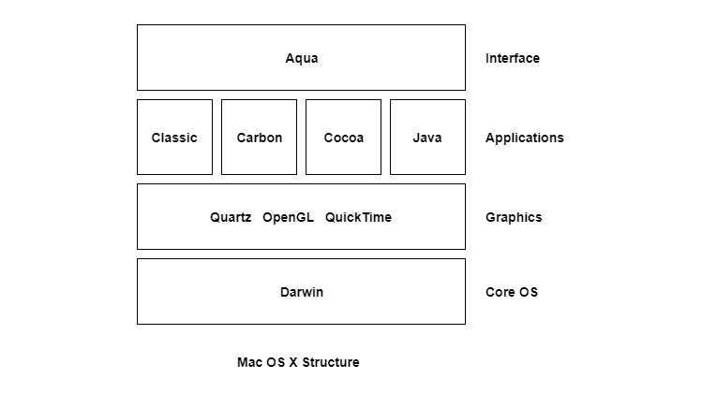
MacOS structure
Layers of macOS structure:
Core OS
Graphics
Applications
Interface

Slide 8
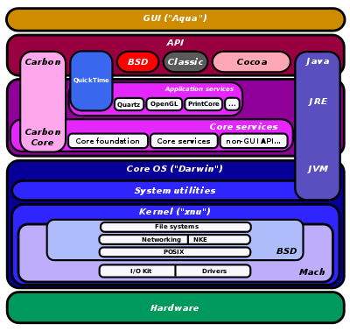
MacOS structure…

Slide 9
Advantages vs Disadvantages
Fewer virus attacks
Good customer support
Similar GUI for all the products:
Performance and long life
Default apps
Support NTFS and FAT
Can run Windows
Expensive
Fewer games and software
No hardware customization
Windows cannot read the MacOS file system
Less hardware used

Slide 10
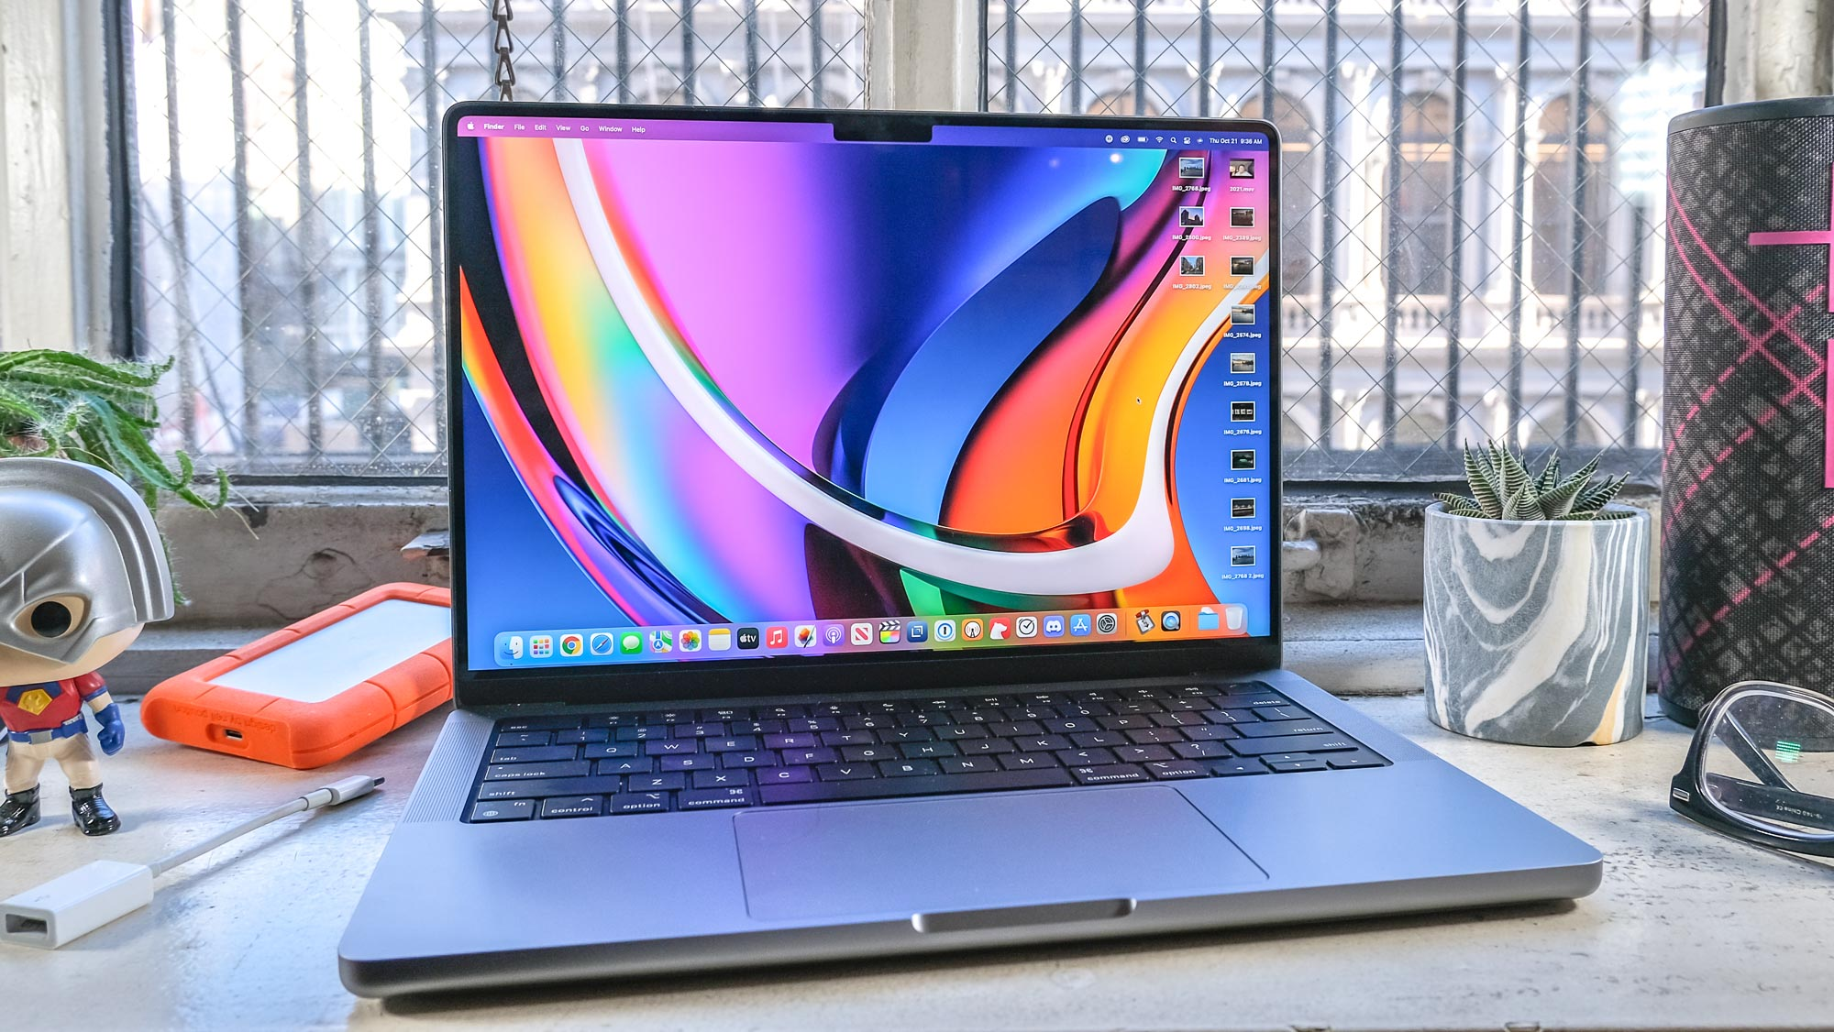
Versions of MacOS
OS X 10.0: Cheetah - 24 March 2001
OS X 10.1: Puma - 25 September 2001
OS X 10.2: Jaguar - 24 August 2002
OS X 10.3 Panther (Pinot) - 24 October 2003
OS X 10.4 Tiger (Merlot) - 29 April 2005
[OS X 10.4.4 Tiger (Chardonnay)]
macOS 10.12: Sierra (Fuji) - 20 September 2016
macOS 10.13: High Sierra (Lobo) - 25 September 2017
macOS 10.14: Mojave (Liberty) - 24 September 2018
macOS 10.15: Catalina (Jazz) - 7 October 2019
macOS 11: Big Sur - 12 November 2020
macOS 12: Monterey - 25 October 2021

Slide 11
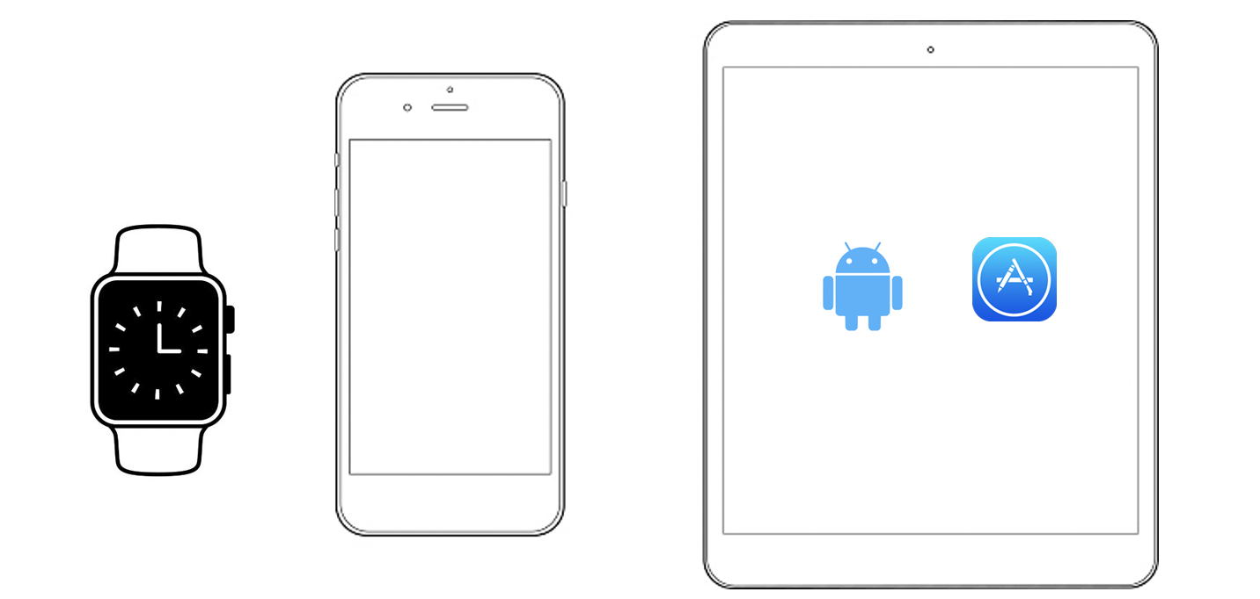
iOS
iOS is a mobile operating system created and developed by Apple Inc. It was created exclusively for Apple devices: iPhone and iPad.
Based on MacOS
Published: 29 June 2007
Second place in the world after Android
Latest version: iOS 15 (September20, 2021)
It is the base for three other operating systems produced by Apple: TvOS and WatchOS.

Slide 12
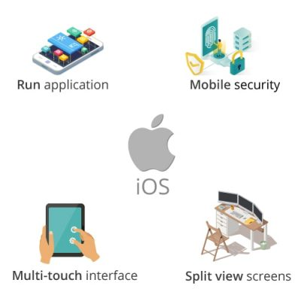
What does iOS do?
The iOS operating system is a type of software that manages all aspects of the iPhone and iPad devices ensuring that the hardware and software of the device can interact.
It also manages many processes that run such as:
Interaction with applications
Security system
Battery
Back-up file
Regularly update etc.

Slide 13
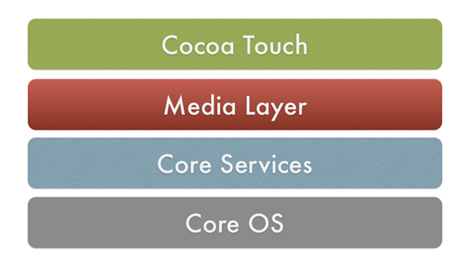
iOS Architecture
Based on UNIX-like OS (Darwin form) iOS has 4 layers:
The layer with which most applications interact.
The layer which contains media services: audio, video or graphics.
The layer which in addition to the above services offers cloud computing, databases, etc.
The layer which offers low-level services which deal with hardware and networks.

Slide 14
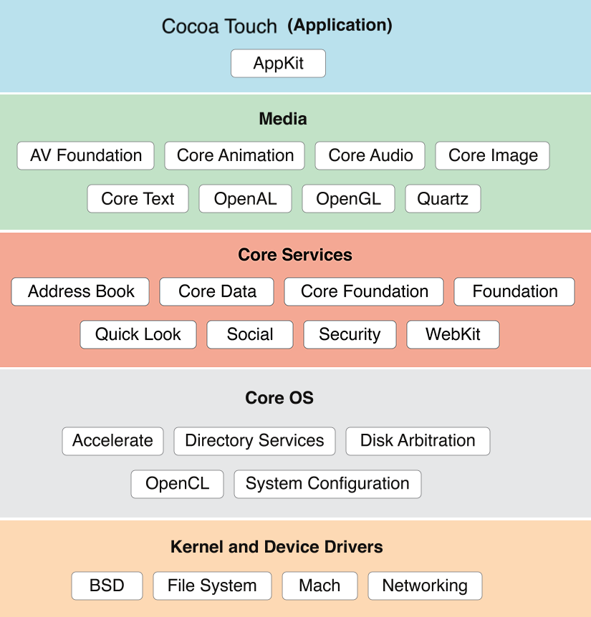
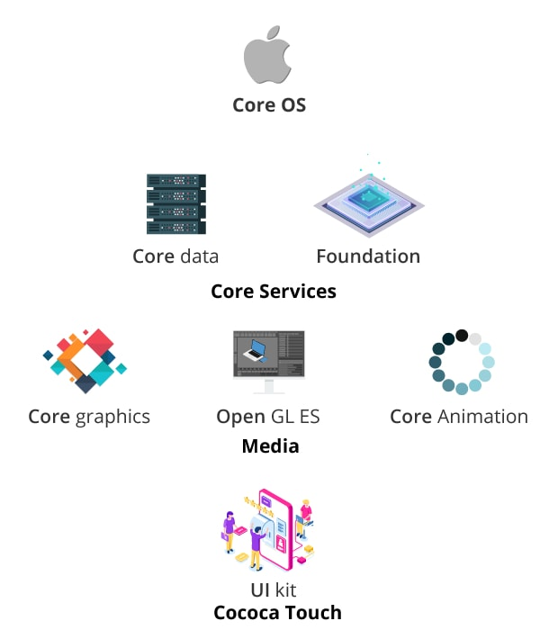
iOS Architecture…

Slide 15
Advantages vs Disadvantages
Simple Interface
Multitasking
Multi-language
Picture Quality
Performance
High security(FaceID,Passcode,TouchID)etc.
Very Pricey
Storage
Not Open Source
Battery
No Customization etc.

Slide 16
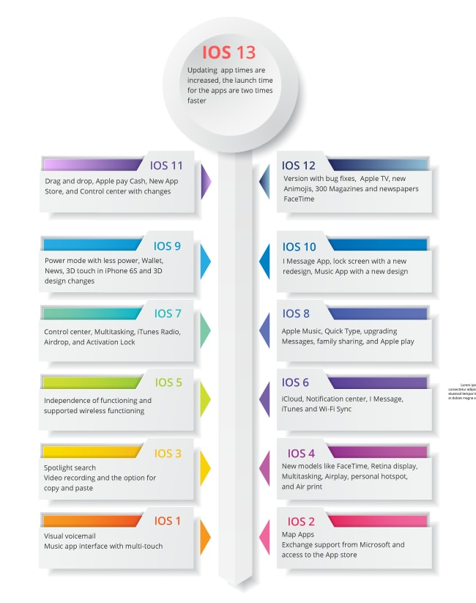
iOS Versions
Multitasking
Social Media
iCloud
In-App Purchase
Game Center
Notification Center
GPS
Bluetooth
Camera Integration
Maps
Email
Location Services etc.

Slide 17
iOS Latest Version
The latest version of the iOS mobile operating system is iOS 15 and supports these Apple devices :
iPhone 13 | iPhone XS Max
iPhone 13 mini | iPhone XR
iPhone 13 Pro | iPhone X
iPhone 13 Pro Max | iPhone 8
iPhone 12 | iPhone 8 Plus
iPhone 12 mini | iPhone 7
iPhone 12 Pro | iPhone 7 Plus
iPhone 12 Pro Max | iPhone 6s
iPhone 11 | iPhone 6s Plus
iPhone 11 Pro | iPhone SE (1st generation)
iPhone 11 Pro Max | iPhone SE (2nd generation)
iPhone XS | iPod touch (7th generation)

Slide 18
Android OS
Android is an open source and Linux-based Operating System for mobile devices such as smartphones and tablet computers.
Android was developed by the Open Handset Alliance.
The source code for Android is available under free and open source software licenses.
Android's source code has been used as the basis of different ecosystems, most notably that of Google which is associated with a suite of proprietary software called Google Mobile Services (GMS).

Slide 19

Why Android?
Open Source
Features:
Inter App Integration
Beautiful UI
Storage-SQLite
Multi-touch
Multi-tasking
Resizable Widgets
Larger Developer and Community Reach
Reduced Cost of Development
Increased Marketing
Higher Success Ratio
Rich Development Enviroment

Slide 20
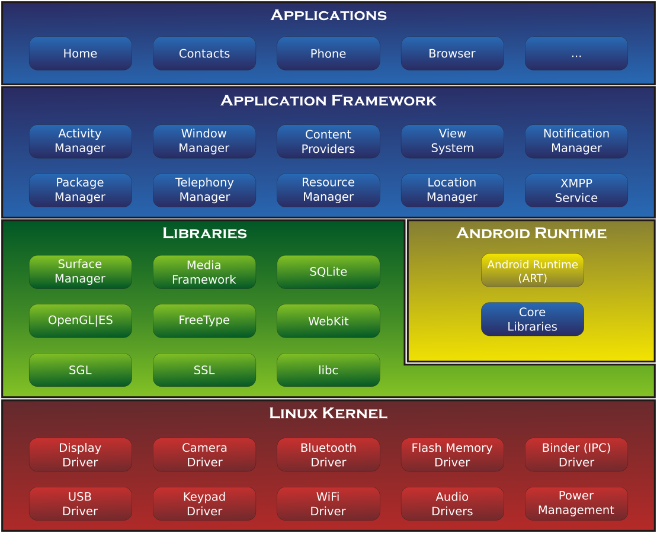
Android Architecture
Briefly elaborate on what you want to discuss.

Slide 21

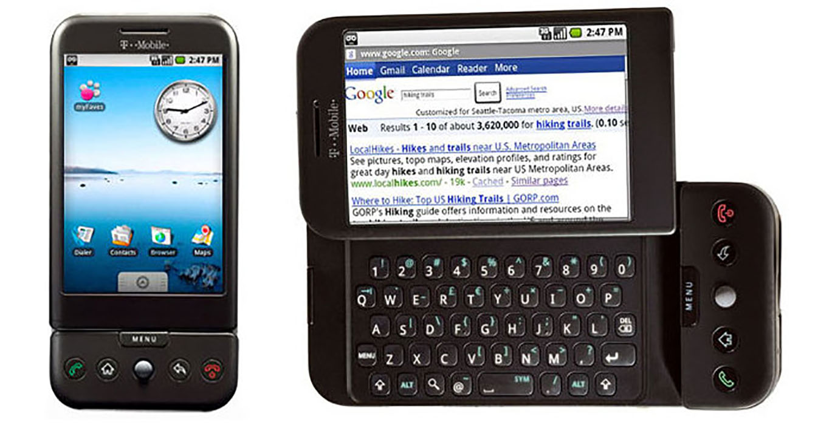
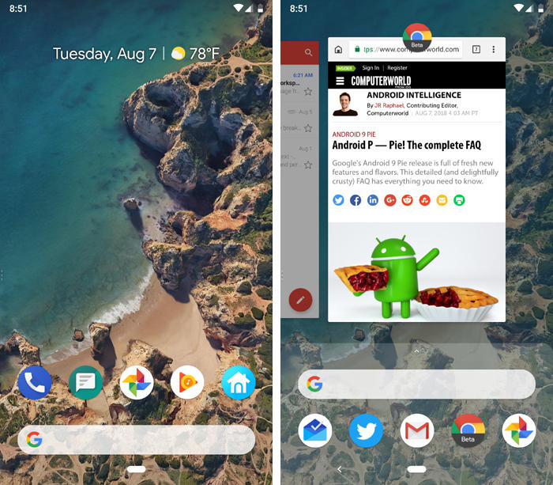
Android Evolution
The Android 1.0 home screen in HTC Dream device and its rudimentary web browser (not yet called Chrome).
Android 9 introduced a short-lived setup for getting around phones with a mix of both gestures and buttons

Slide 22
Reference
https://www.c-sharpcorner.com/UploadFile/d49768/core-os-layer-in-iphone/#:~:text=The%20Core%20OS%20Layer%20is,file%20system%20handling%20and%20threads.
https://www.besanttechnologies.com/what-is-ios
https://medium.com/@anuradhs/ios-architecture-a2169dad8067
https://www.slideshare.net/PalanikumarM2/hybrid-mobile-app-70585133
https://en.wikipedia.org/wiki/IOS
https://www.itrelease.com/2019/10/what-are-advantages-and-disadvantages-of-macos/
https://www.tutorialspoint.com/mac-os-x-structure
https://support.apple.com/en-gb/HT201260
https://newbedev.com/cocoa-versus-cocoa-touch-what-is-the-difference
https://en.wikipedia.org/wiki/MacOS_version_history
https://en.wikipedia.org/wiki/MacOS

Slide 23
Thank you for your time!

